Slide 1

AI Ethical Issues And Concerns

Slide 2
Introduction to AI Ethical Issues
Artificial Intelligence has been rapidly developing technology for decades and its applications are becoming increasingly prevalent in our daily lives. AI has potential to revolutionize many industries and processes, but it also raises ethical issues that need to be considered.
AI technology is often designed to be unbiased, but it can be difficult to ensure that the data it is trained on is free from bias. This can lead to decisions being made that are not representative of the population, or that favor certain groups of people.

Slide 3
Issues And Concerns Around AI
Inaccuracy
Data breaches
Lack of quality data
Misuse of private data
Reduction of human contact
Negative impact on health
Lack of Creativity
Cost to innovation
Unemployment
Violation of human rights
Loss of human decision-making

Slide 4
AI And Ethical Concerns
Data Privacy
Security
Liability
Bias & Discrimination
Inequality
Accountability & Transparency
Potential for Military use
Potential for criminal and malicious use

Slide 5
Data Privacy & Security
AI systems can be used to monitor people’s activities and behaviors. Hence it can collect and analyse large amount of data. This can lead to loss of privacy and can be used to target people for specific advertisement or to make decisions about their lives.
It is important to ensure that this data is kept secure and is not used for any malicious purposes. We also should ensure that these systems are used responsibly and ethically by implementing secure design principles for AI systems. And it is important to continuously monitor and audit AI systems.

Slide 6
Accountability & Transparency
AI Systems are often used to make decisions that can have significant impact on people’s lives. Hence these decisions should be in a transparent and accountable manner. If not then it leads to unfair outcomes for some people.
Building AI Systems with transparency and explainability will ensure accountability and mitigates the security issues.

Slide 7
Bias & Discrimination
Biased data can lead to unfair treatment of certain individuals or groups and can exacerbate existing social inequalities. Bias in AI systems can be caused either by the way data is collected or the way algorithm is designed.
For eg., AI system trained on data belonging to a particular demographic cannot make accurate predictions for other demographic.

Slide 8
Liability
Machines learn from experience and it takes decision without human control. when things go wrong, there are no current legal regimes that could provide protection for the victims.
A big question arises that “Who is liable when an AI system makes mistakes or causes harm?”

Slide 9
Potential for Military use
There are certain risk associated with incorporation of AI in Military operations. AI could be used to create autonomous weapons that could threaten the existence of humanity.
It has potential to revolutionize warfare but it could become more dangerous tool too.

Slide 10
Abuse/Malicious uses
Cyber criminals use AI to automate content generation for phishing and email compromise scam that could lead more accurate defrauding of businesses.
AI is also abused to manipulate cryptocurrency trading practise.
AI Facial Recognition drones are used for single-person bombing.

Slide 11
AI And Bias

Slide 12
AI Bias
Bias is the inclusion of inaccurate or prejudicial information in data sets, algorithms, or models that results in spurious conclusions.
Though AI is build to make better decisions, it is often just as biased as the humans who create it.
Bias causes inaccurate predictions and faulty decision-making results in harmful consequences for individuals and society.
We could create algorithms that are designed to be fair and unbiased.

Slide 13
AI and Bias
Gender Bias
Social Bias
Racial Bias
Algorithm Bias

Slide 14
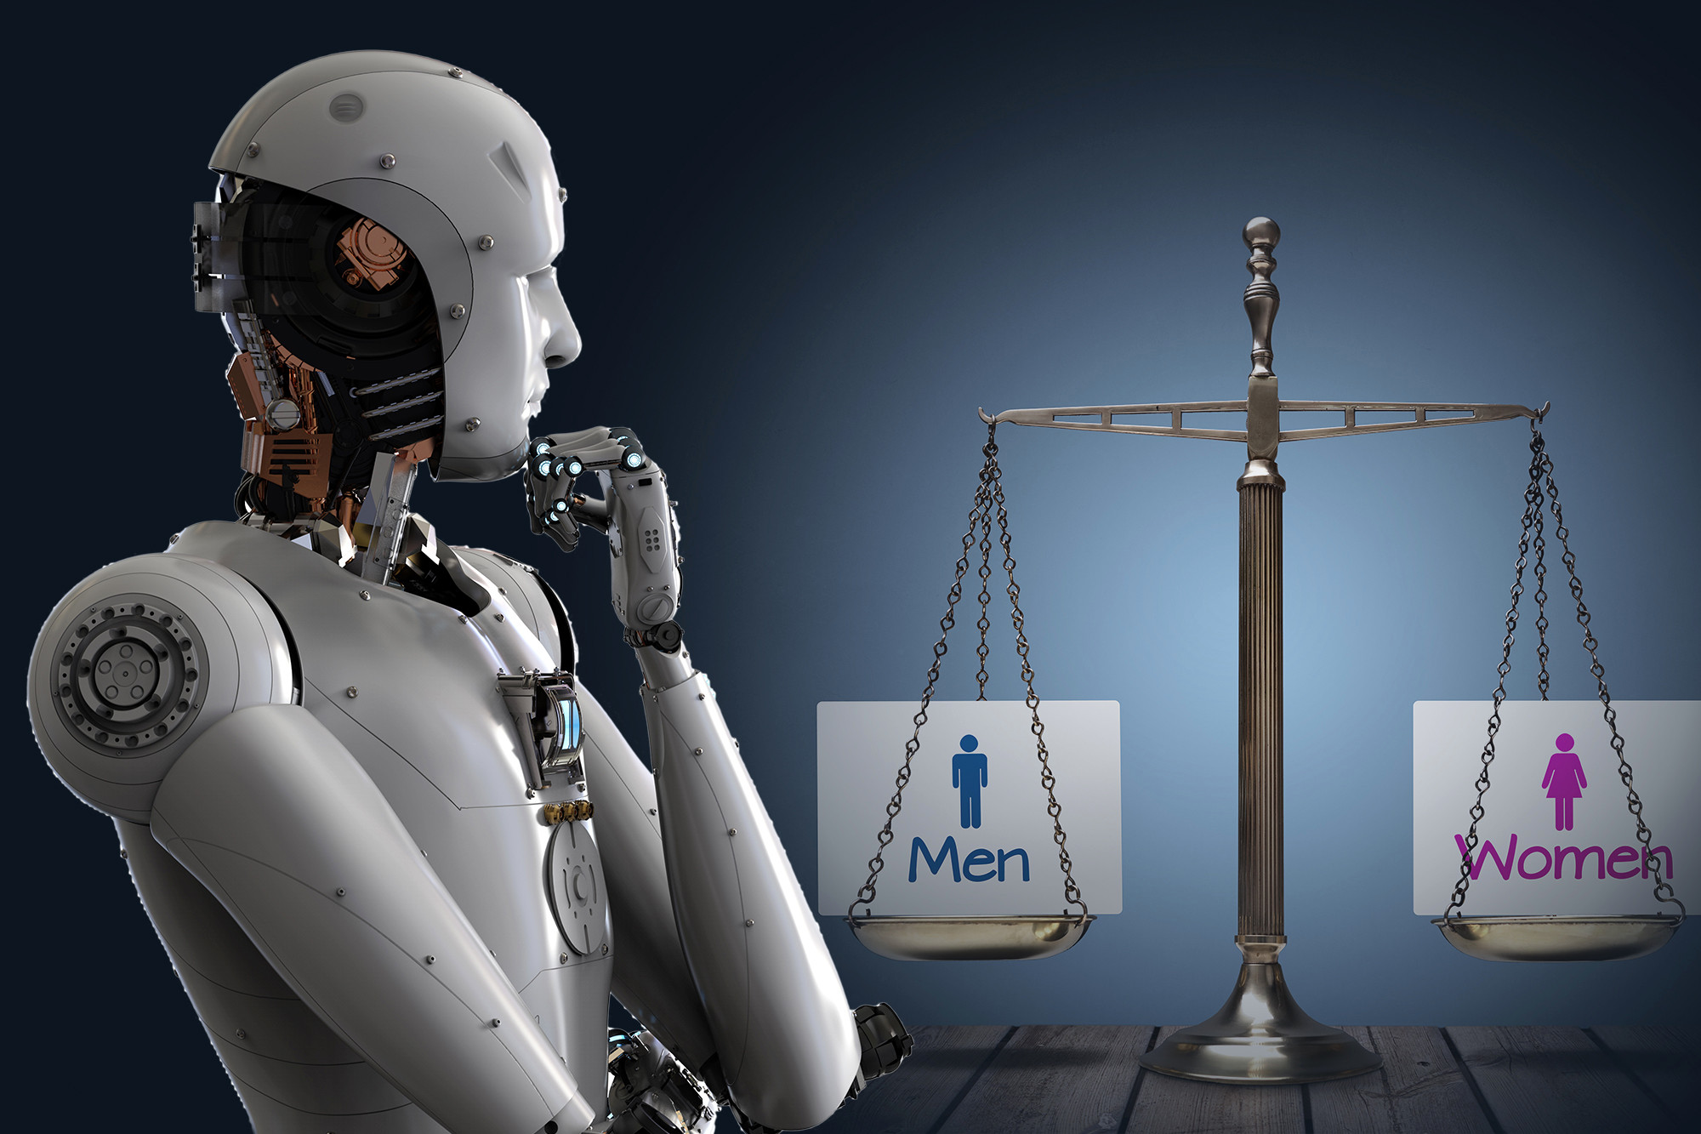
Gender Bias - Amazon Hiring Algorithm
Amazon used CVs which it had over 10-year period to train its AI algorithm and found that there was male dominance, given low proportion of women working in the company.

Slide 15
Social Bias - COMPAS
Correctional Offender Management Profiling for Alternative Sanctions AI in USA was used to predict which criminals are more likely to re-offend in the future. Based on the forecast, judges make decisions for jail sentence or bail or release. The impact of COMPAS was, black criminals were judged to be much more likely to recommit crimes in the future whereas white criminals were judged to be less risky.

Slide 16
Racial Bias - US Healthcare AI Algorithm
There were few AI algorithms used in Healthcare and later was found that these algorithms were prioritizing care coordination for white patients over black patients for the same level of illness. The algorithms was trained on costs in insurance claims data, predicting which patients would be expensive in the future based on who was expensive in the past. Historically, less is spent on black patients than white patients, so the algorithm ended up perpetuating existing bias in healthcare.

Slide 17

Algorithm Bias - Microsoft Tay Chatbot
Tay - “Thinking About You” AI chatbot was designed to learn from people and interact with them on its own. After 16 hours of release it was shut down as people started messing around and taught her inappropriate things.
It is the best example of a saying, “Any AI System learning from bad examples could end up socially inappropriate.”

Slide 18
AI: Ethics, Bias, Trust
AI is more powerful and ubiquitous. Hence its capabilities will increase and that raises the potential for abuse and misuse of AI technologies.
Instill human values in AI to build trust. Ethical AI builds trust between humans and machines.
Mitigate the bias by using large amount of data, pre-processing the data, regularly evaluating the AI system and removing unwanted biases.
Building trustworthy technology prevents false profiling.

Slide 19
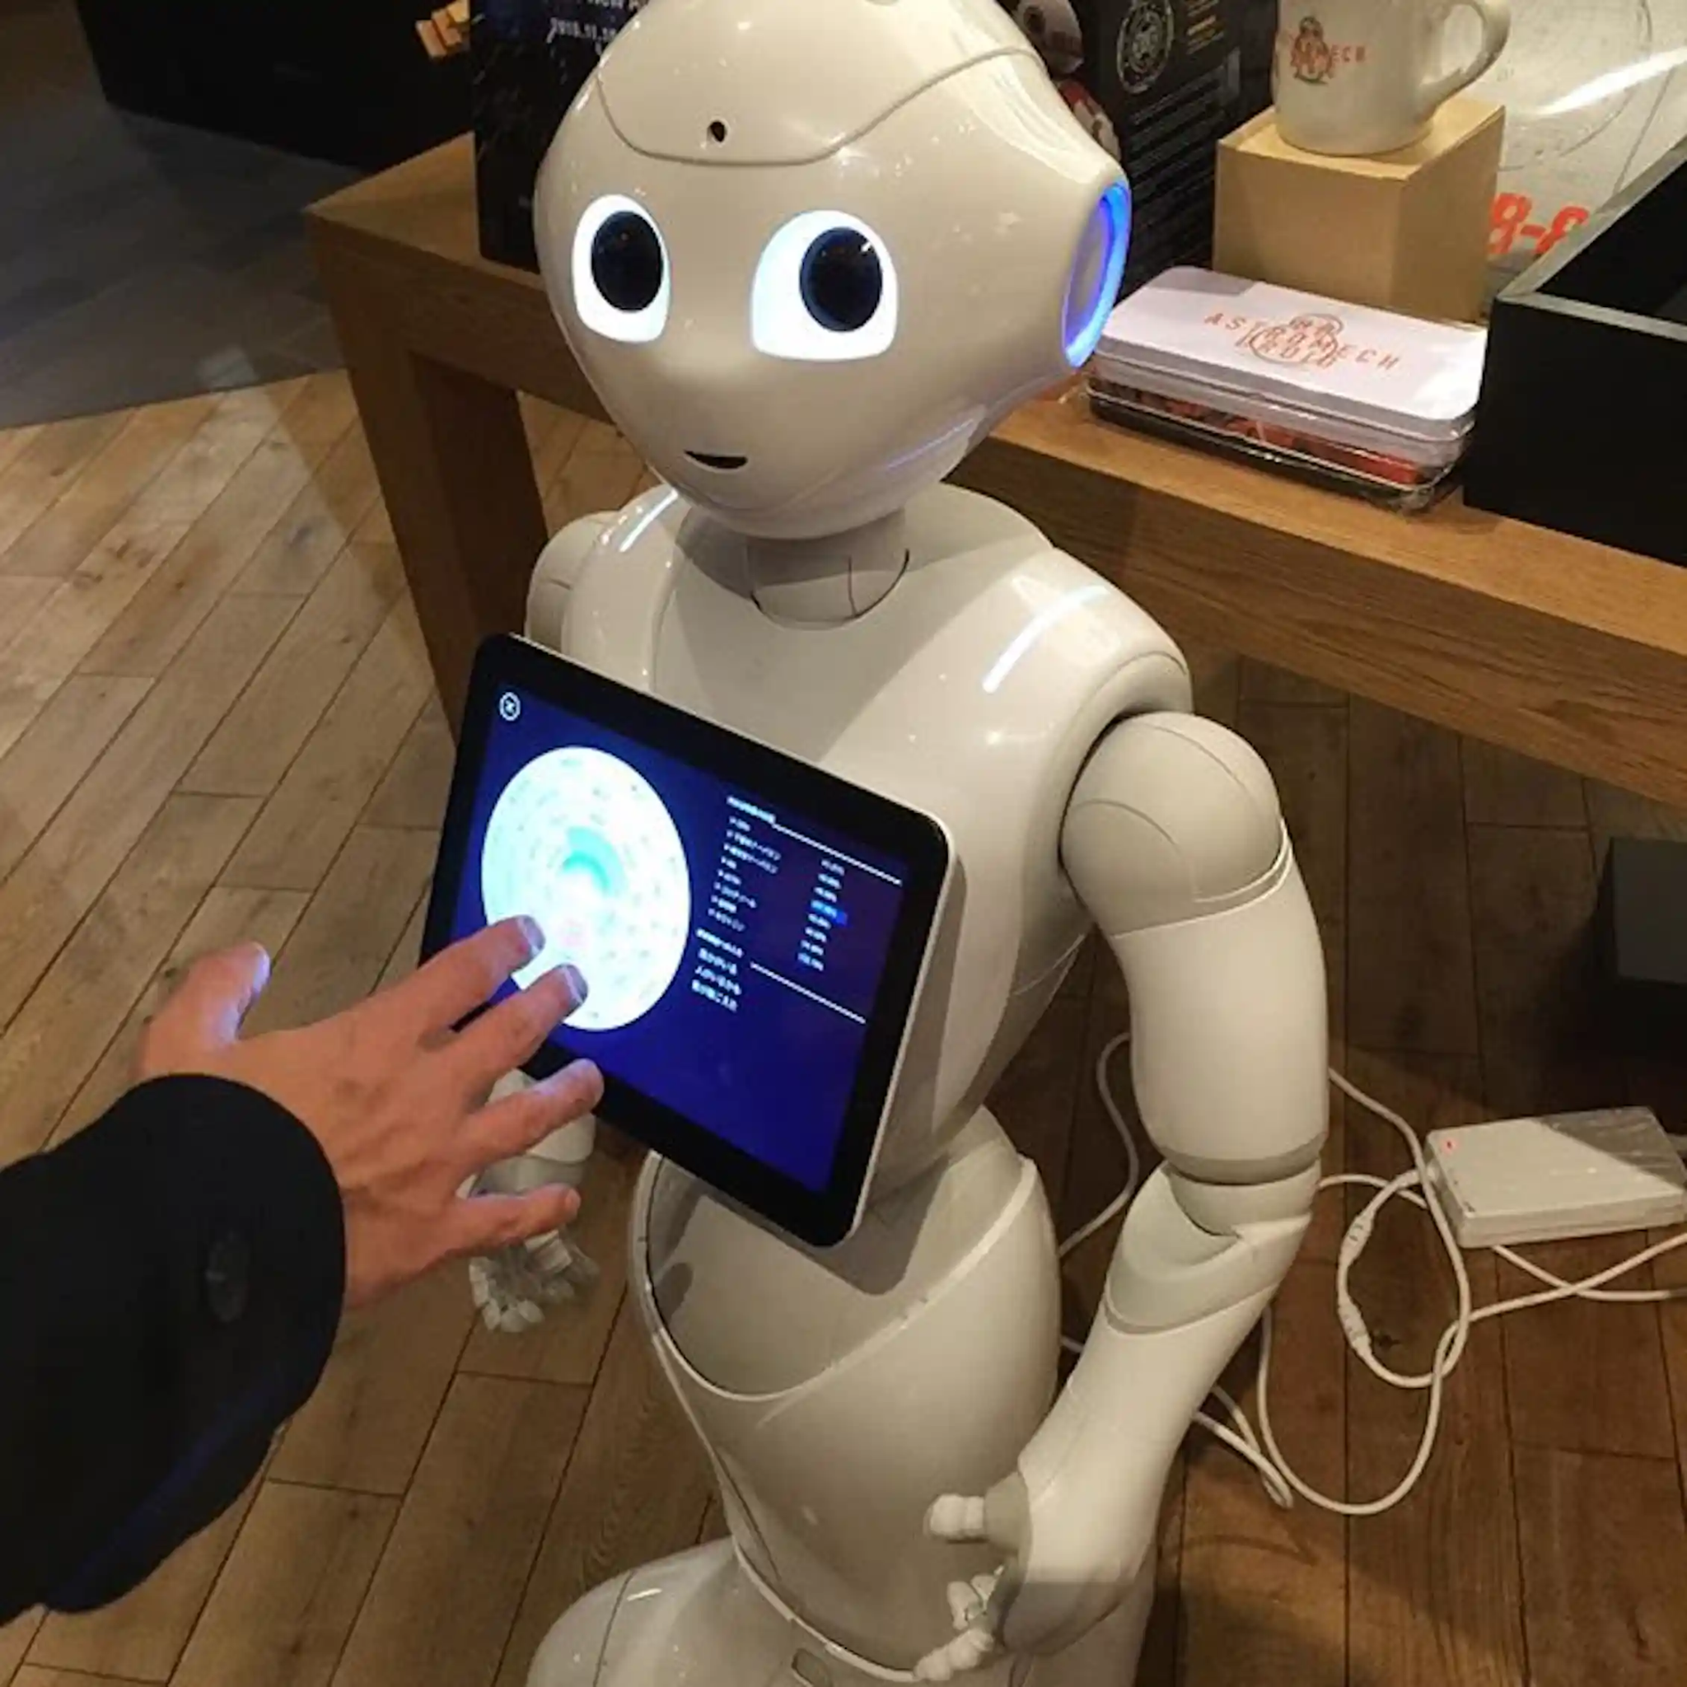
Conclusion
AI poses significant risk. It is important for organizations to understand these risks and take steps to mitigate them.
By implementing secure design principles, continuously monitoring and auditing AI systems, and having a framework in place to address bias, we can ensure that AI technology is used to its fullest potential and not used for any malicious purposes.
AI technology should be used responsibly and ethically, and ensure that it is designed to benefit society.
As AI becomes more ubiquitous, it is important to build trust between human and machines.

